Slide 1


Migros Zurich
Analytics
Where to create the new Migros Store in the city of Zurich?
Notes:
Research Question: Where to create the new Migros Supermarket in Zurich

Slide 2
Overview
Initial Ideas
Data Collection
Model
Results
Conclusion and next steps
Questions
Analytics
Notes:
Initial Idea →Martina
Data Collection → Lisa
Model → Ruben
Results → Mario
Conclusion and next steps → Mario
Questions → all

Slide 3
I. Initial Idea
Essential data
Assumptions
Analytics
Notes:
Research Question: Where to create the new Migros Supermarket in Zurich
-Population

Slide 4
Essential data/ potential predictors
Population
Migros
Population Density
Household Density
Demographic information: age, income
Migros locations
Migros within 500 m
Businesses
Competitors
Business Density
Employee Density
Name of competitors (Coop, Lidl, Aldi, Spar)
Type of competitor (highend, medium, Discounter)
Public Transport
Infrastructure
Public Transport Distance
Public Transport Quality (type and number)
Distance to next stop
Noise street
Building Footprint
Number of buildings within 500m)
Notes:
Idea: People are living nearby or passing nearby
-Different Approach: not a predicting model, but layering different information on a map

Slide 5
II. Data Collection
Locations of Migros Stores in Zurich
Locations of Migros Competitors in Zurich
Business Locations in Zurich
Data provided by UrbanDataLab
Analytics
Notes:
We used Google services

Slide 6
Map of Zurich

Slide 7

Data provided by UrbanDataLab
Information about the population
Analytics

Slide 8

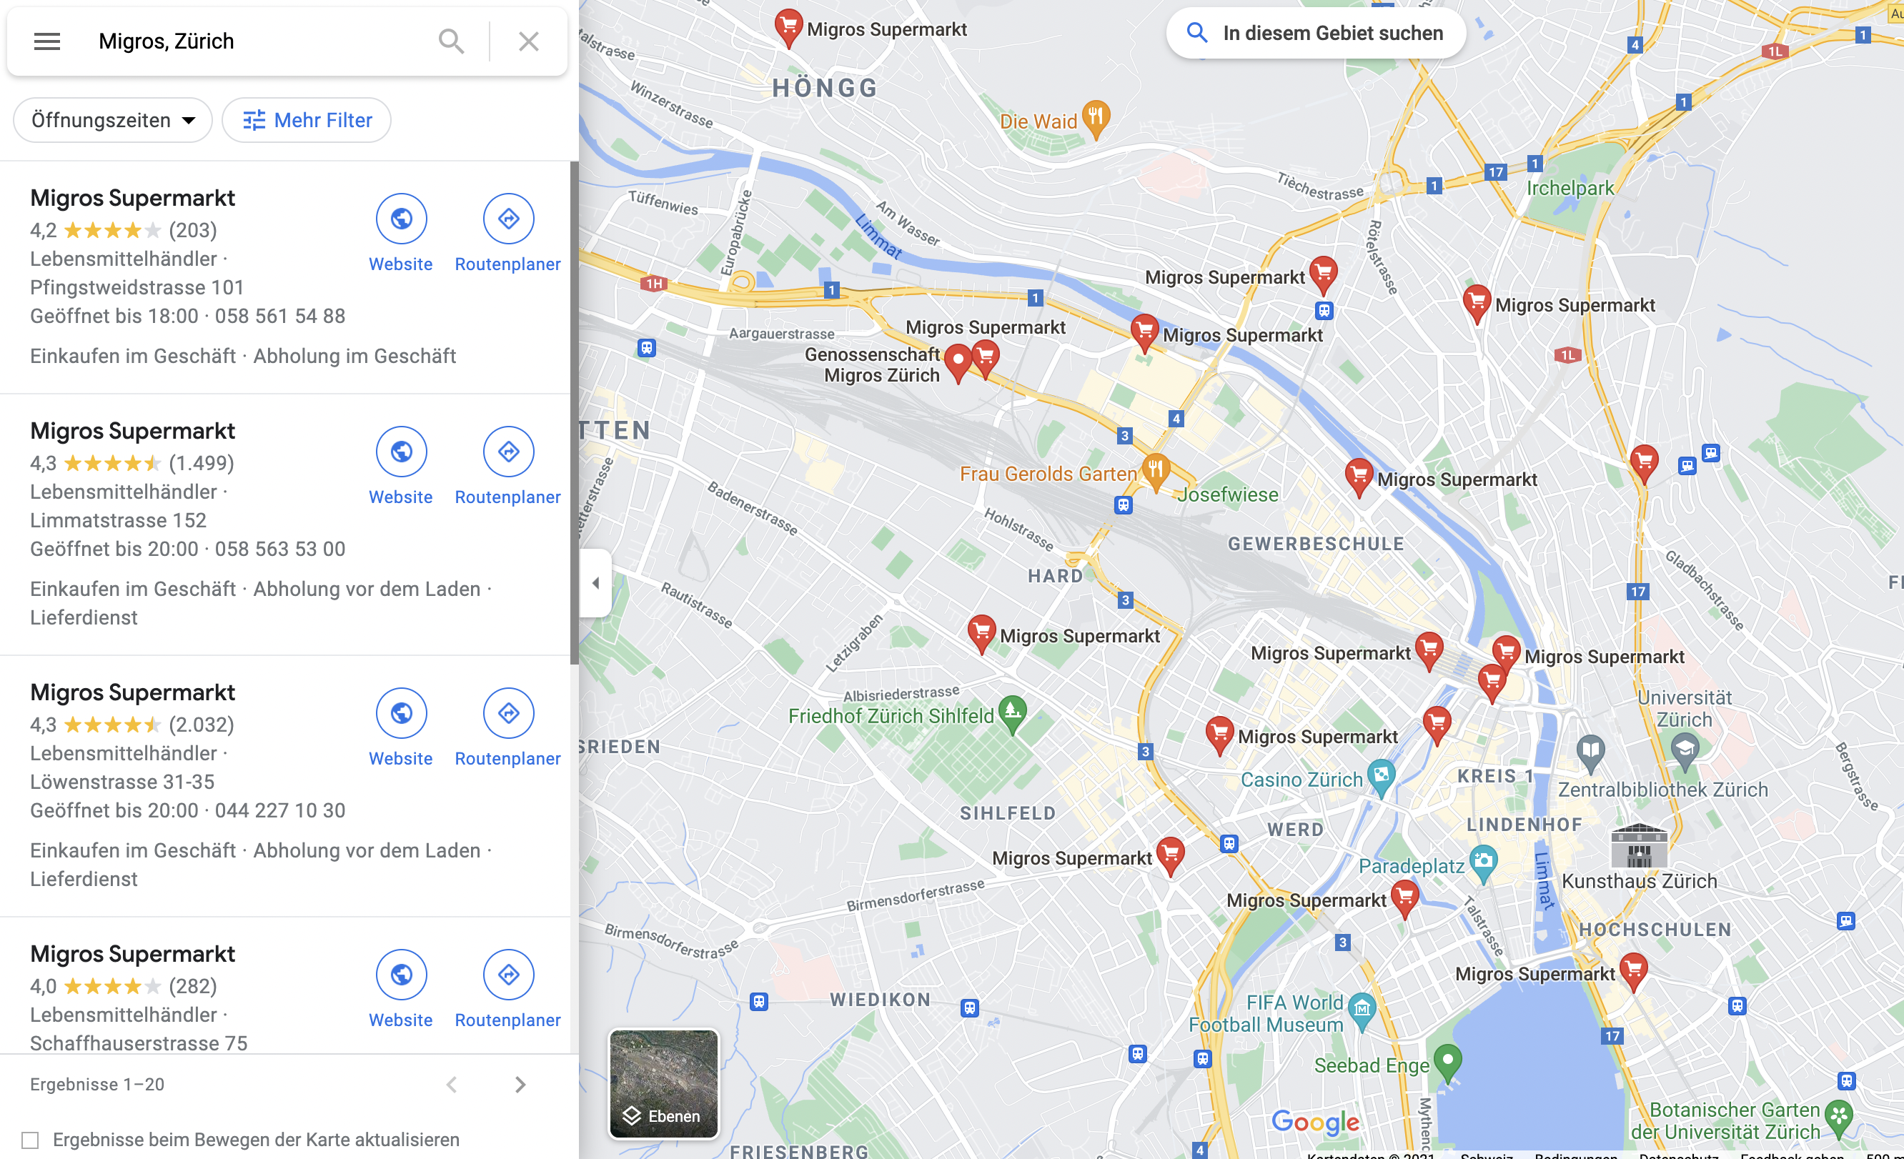
Migros Stores in the City of Zurich
Number: 45
Analytics

Slide 9
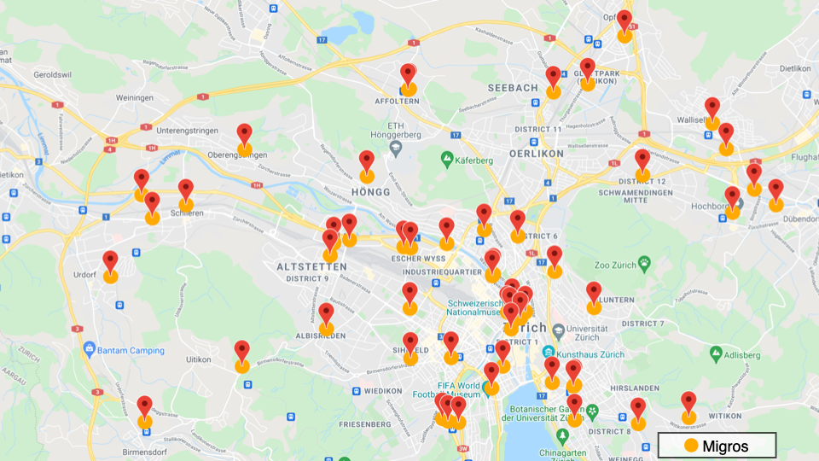

Slide 10


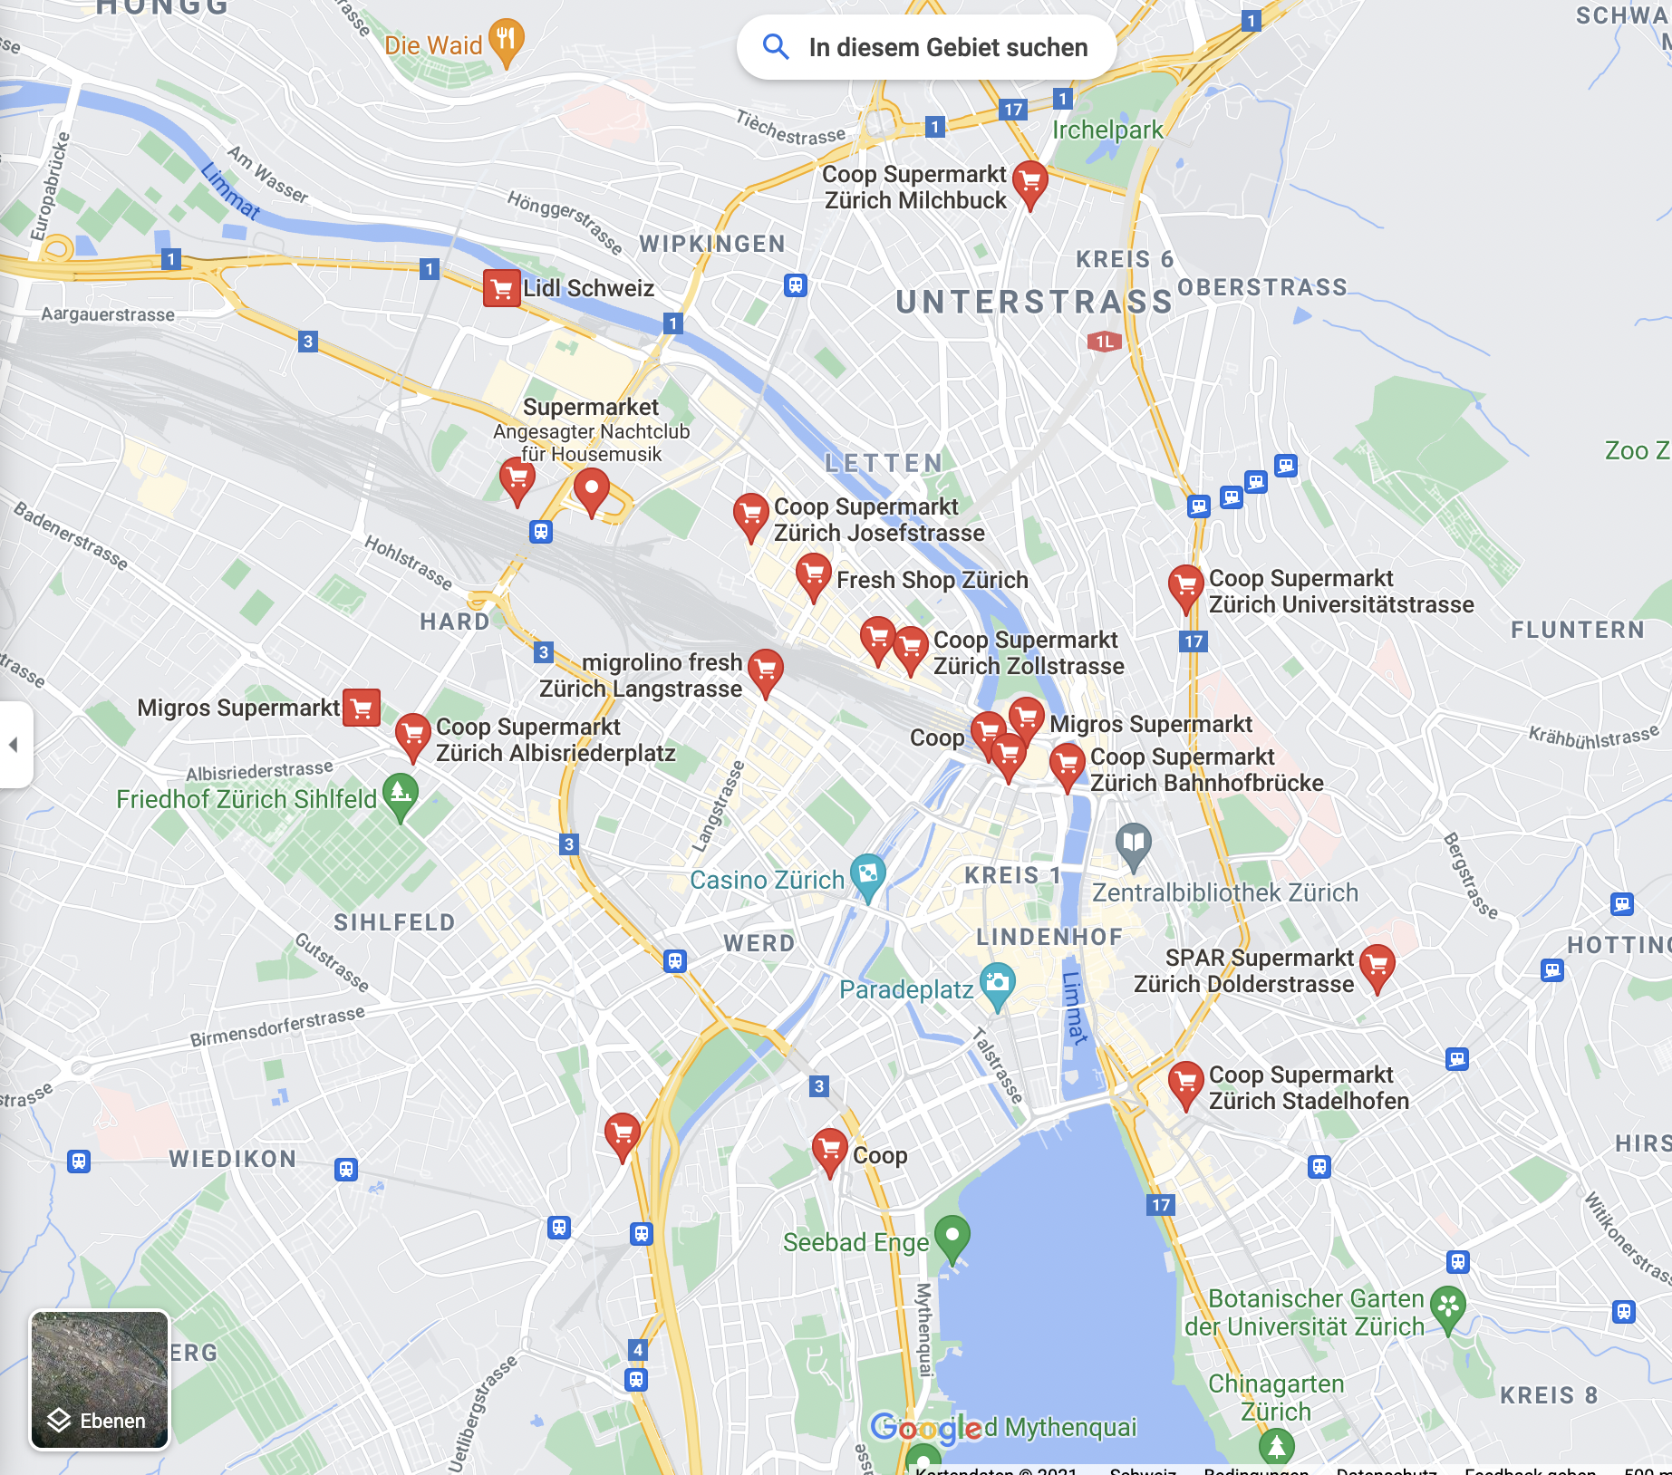


Our Competitors in Zurich
Number of Coops: 89
Number of Discounter: 58
Other: 25
Analytics
Notes:
Discounter: Aldi, Lidl
Other: Spar

Slide 11
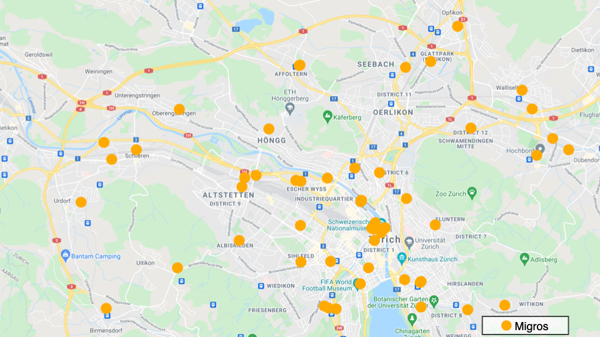

Slide 12
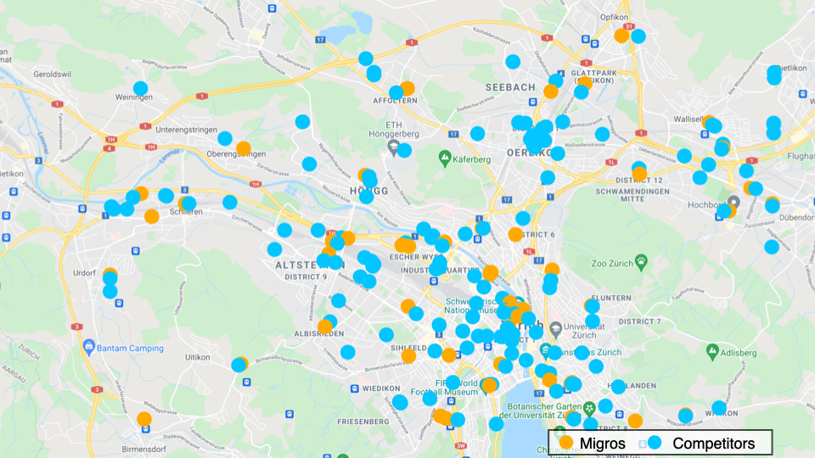

Slide 13
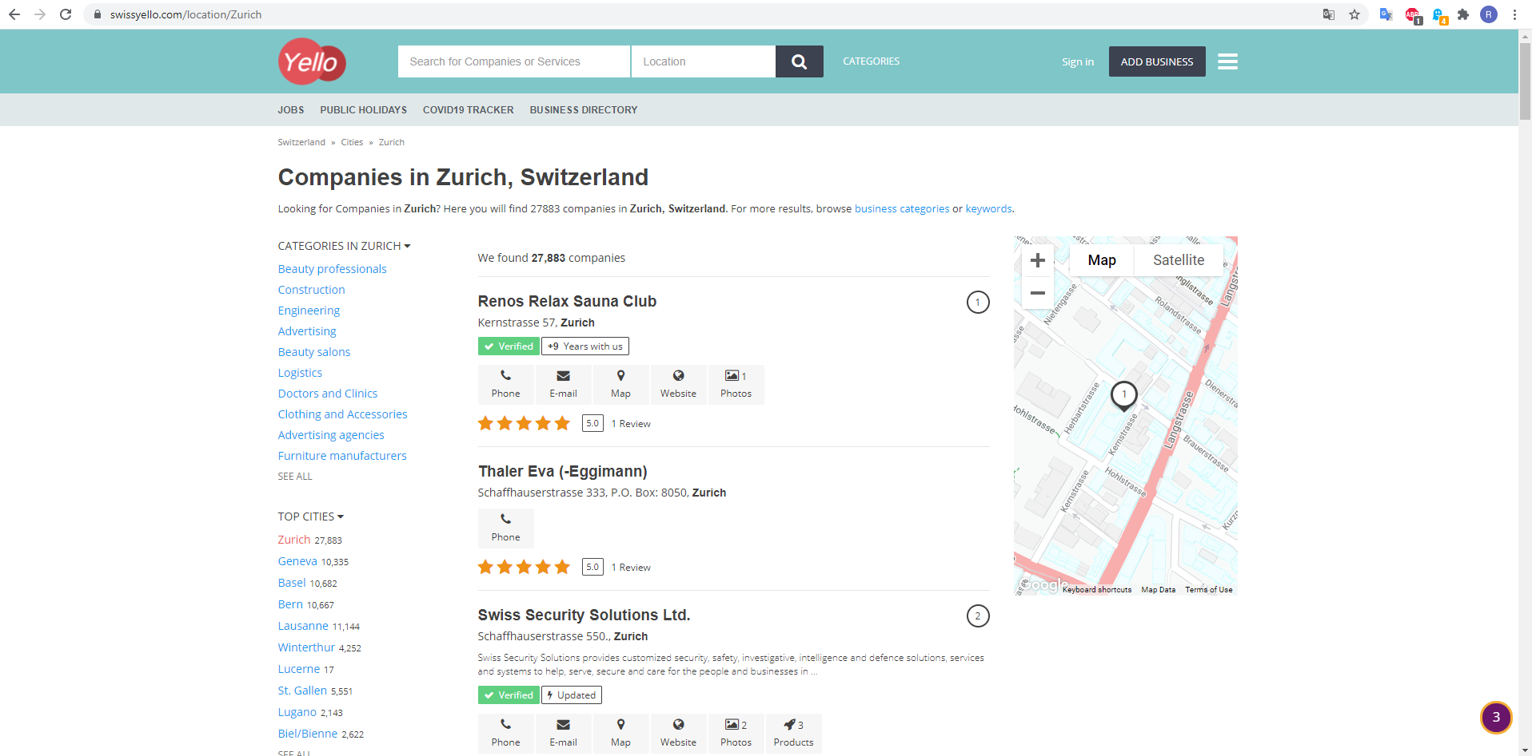
Business Locations in Zurich
27.883 businesses in the city of Zurich
Analytics

Slide 14
III. Model
Logistic Regression
Mapping
Analytics
Notes:
Research Question: Where to create the new Migros Supermarket in Zurich
-Population

Slide 15



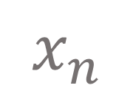
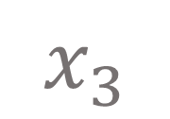
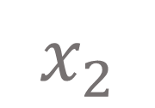
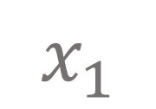
Logistic Regression
$$x_{1}$$
$$x_{2}$$
$$x_{3}$$
$$(⋮)$$
$$x_{n}$$

Slide 16
Mapping
Population Density
Distance to the main station

Slide 17
IV. Results
Business Density
Household Density
Public Transport Distance:
Migros within 500 m
Analytics
Notes:
-What our model suggests
-More interesting to further investigate

Slide 18
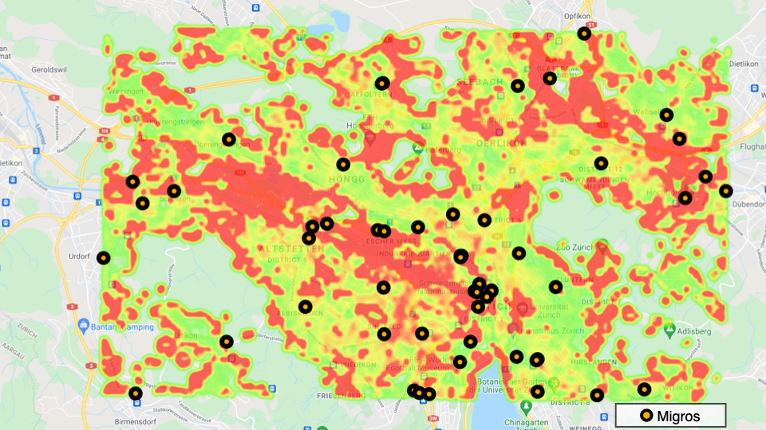

Slide 19
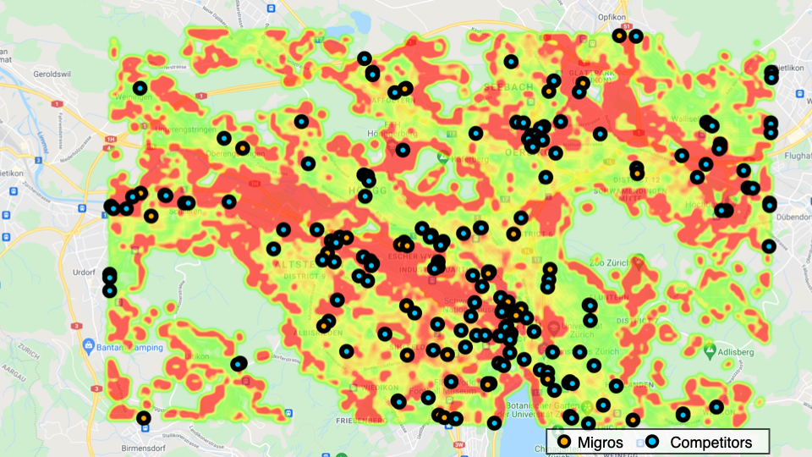

Slide 20
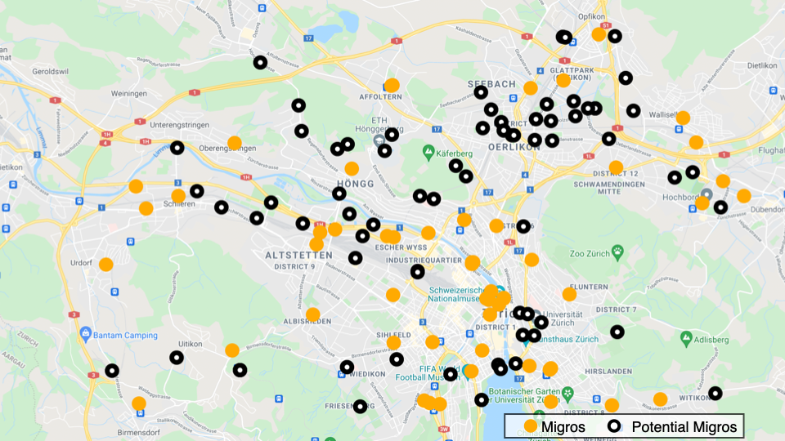

Slide 21
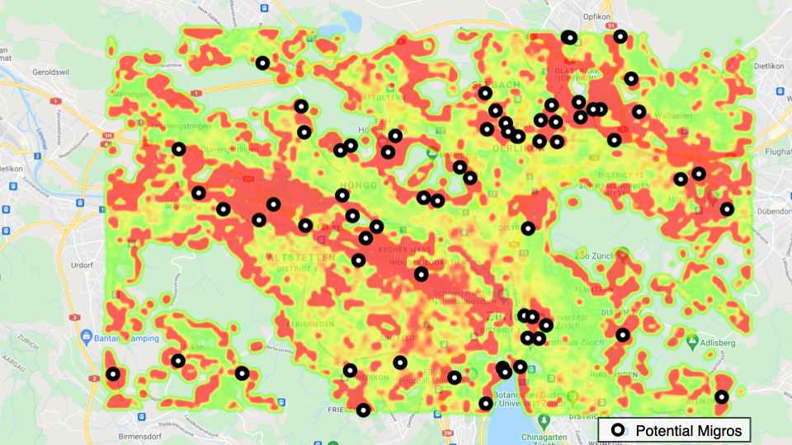

Slide 22
V. Conclusion and Next Steps
Conclusion
Next steps
Analytics
Notes:
-We have a tendency/ area
-This is a update meating
-Next steps…
-What would make our model better: more time to test other model
-More/ different data

Slide 23
Next Steps
Review Model
More Data
Different Model

Slide 24
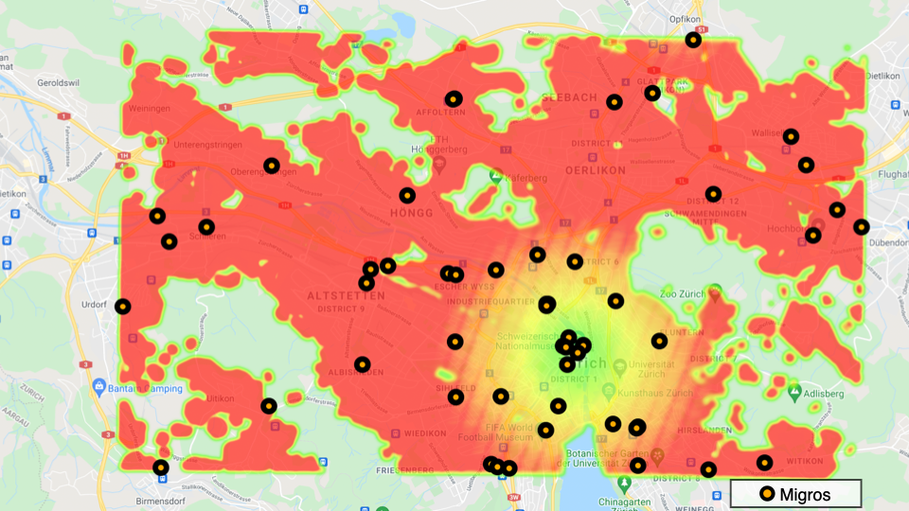

Slide 25
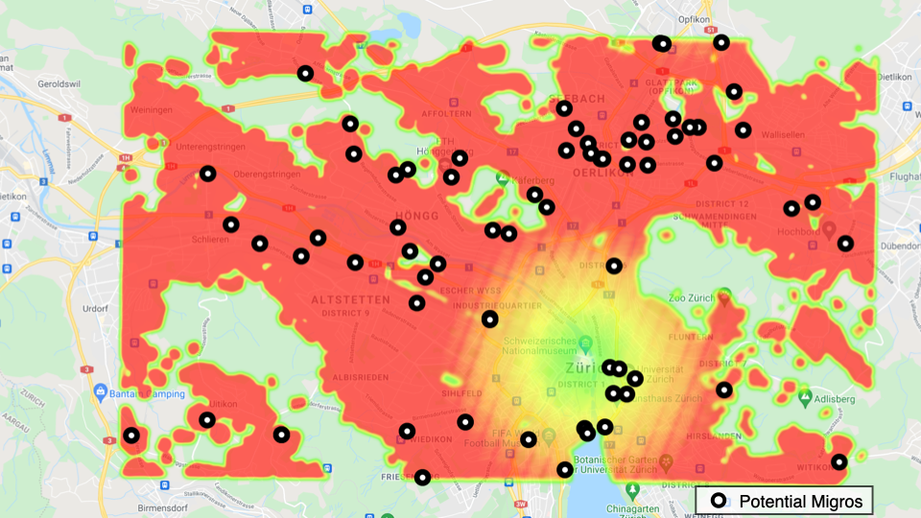

Slide 26
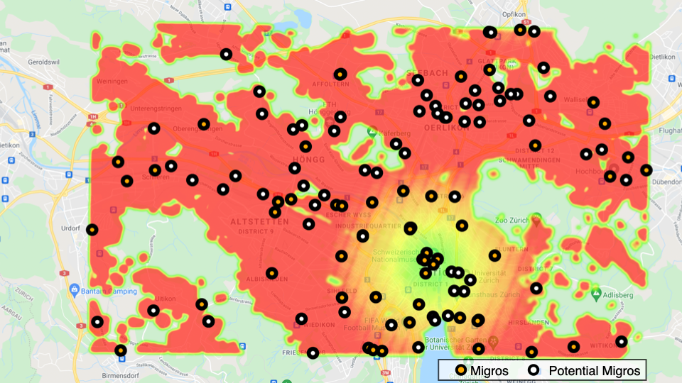

Slide 27

VI. Questions and Discussion
Analytics
Notes:
-We have a tendency/ area
-This is a update meating
-Next steps…
-What would make our model better: more time to test other model
-More/ different data

Slide 28
VI. Questions and Discussion
Questions
Discussion
Analytics
Notes:
-We have a tendency/ area
-This is a update meating
-Next steps…
-What would make our model better: more time to test other model
-More/ different data

Slide 29

Thanks for your attention!
Presented by: Ruben Coll, Mario Kovacs, Martina Trippel and Lisa Christl
Analytics

